Slide 1
Why you should attend SURE 2023
Friday, 13 October 2023
Grangegorman
#SURE2023

Slide 2
SURE 2023 Conference
At a Conference, researchers present their research findings to each other and discuss the progress in their field.
Most conferences are for professional researchers and research students, who showcase their own research.
SURE 2023 is different
SURE 2023 a conference for people who completed research as undergraduate students their final year project who want to both:
Present their research findings to each other, and
Advise other students on how to complete an awesome final year project

Slide 3
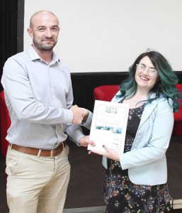
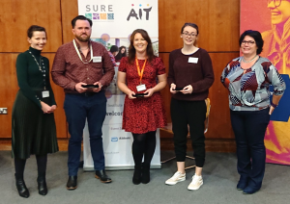
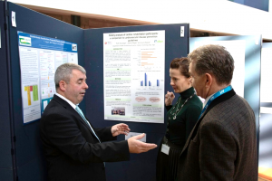
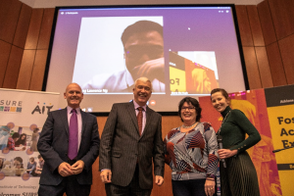
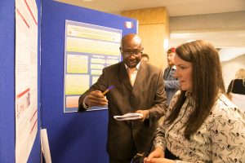
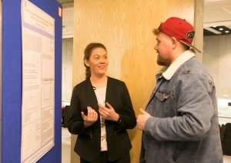
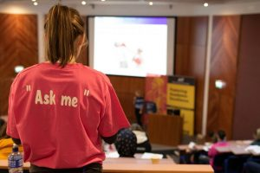
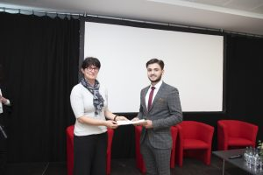
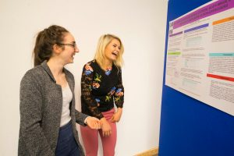
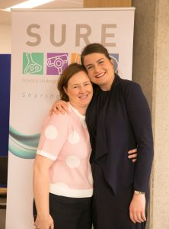
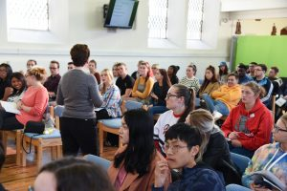
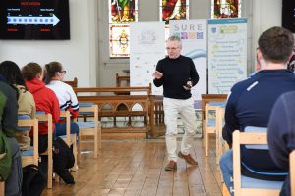
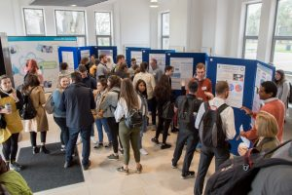
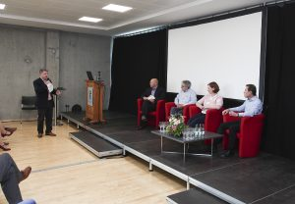
Past SURE Conferences

Slide 4
Who should attend SURE 2023?
The SURE 2023 will mostly be students who are starting to think about their final year project.
These can be students in final year, or students at earlier years of their studies.
While the presentations will all be from students who completed Science, Computing or Mathematics programmes, students from all disciplines are welcome to attend.

Slide 5
Why should you attend SURE 2023?
At the conference, you will hear from 57 recent graduates from around Ireland about their experience of completing their final year project last year.
Each of these 57 graduates will present their final year project and provide their advice on “how to do an awesome final year project”.
In the morning keynote presentation, you will hear from entrepreneurs who have successfully commercialised their undergraduate research.
In the afternoon fireside discussion, you will get advice from experienced final year project coordinators across a range of disciplines on “how to do an awesome final year project”.
At lunchtime, you can talk informally with presenters during our “Pizzas and Posters” session. Lunch (Pizzas) will be provided.

Slide 6
Why should you attend SURE 2023?
This is the perfect way for you to start thinking about your final year project, learning from and building upon the success of the 57 presenters.

Slide 7
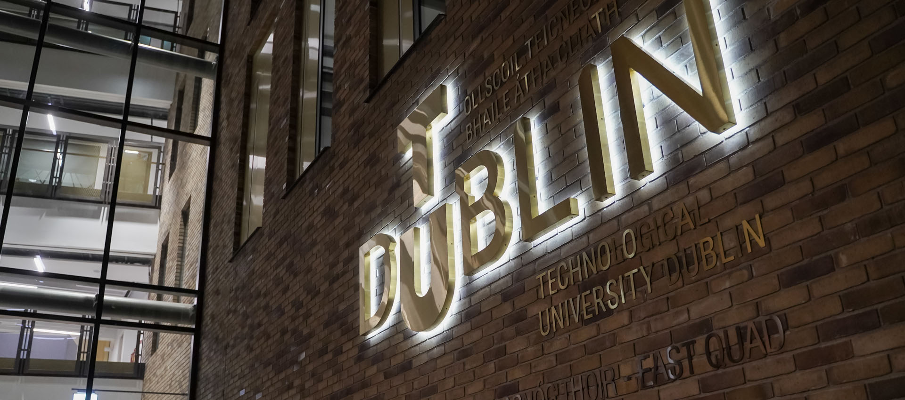
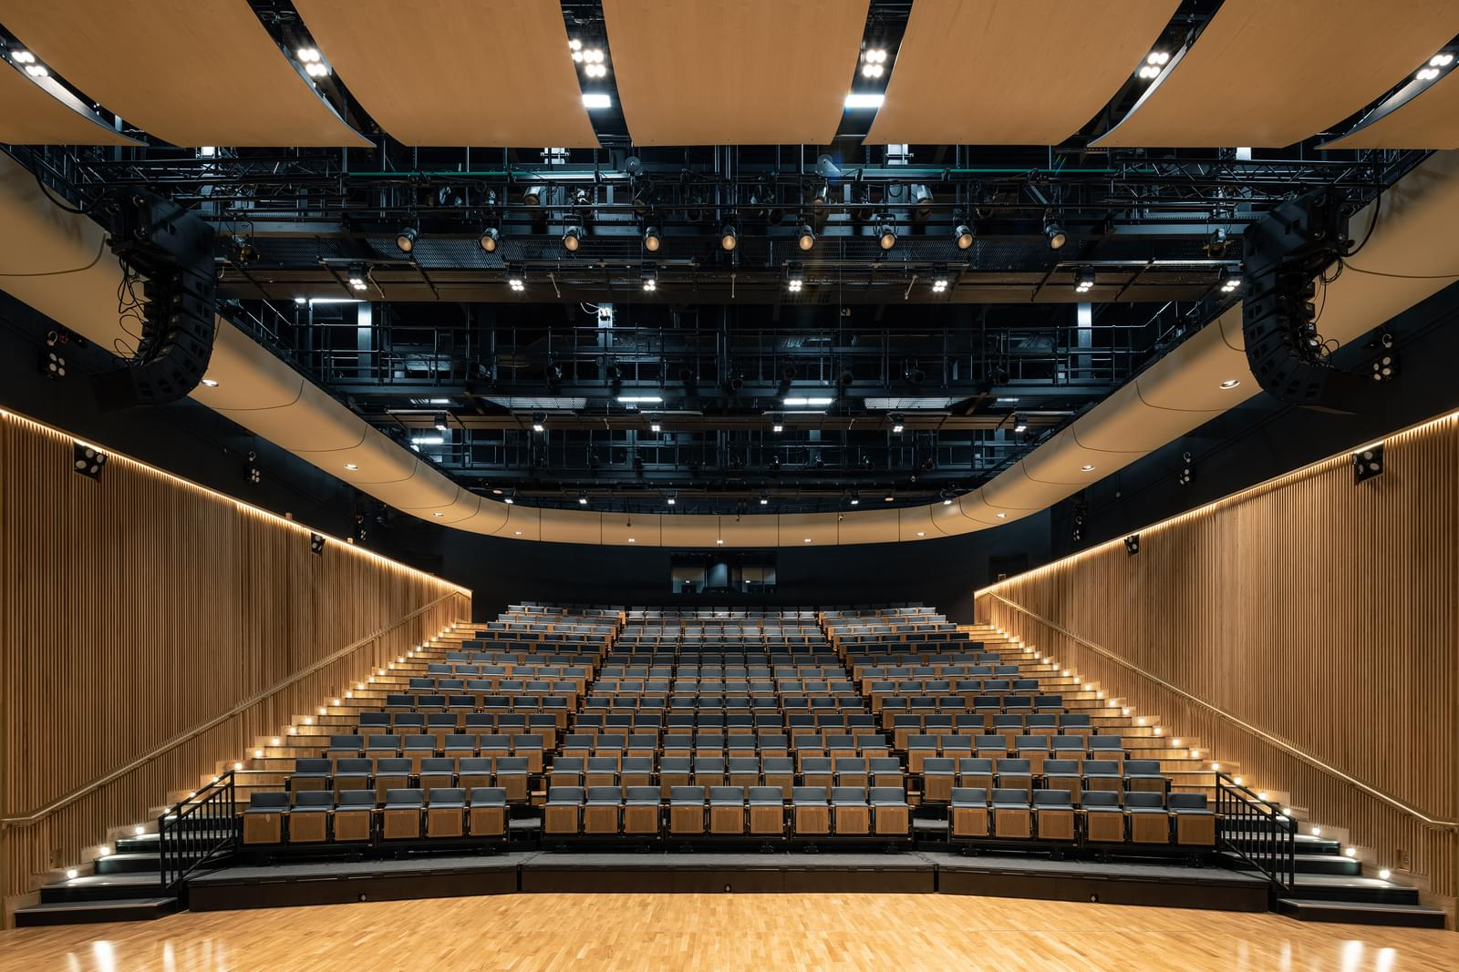
Where and when is SURE 2023 taking place?
SURE 2023 is taking place in the East Quad Concert Hall in the Grangegorman Campus of Technological University Dublin.
SURE 2023 is taking place from 9:30am to 4:30pm on Friday, 13 October 2023.

Slide 8
How can I attend SURE 2023?
There are a limited number of tickets for SURE 2023.
You need to complete the registration form by Monday, 25 September 2023 to give yourself the best chance of getting a ticket.
The registration form is linked to on the Conference Webpage:
https://sure-network.ie/conference/
By the end of September, people who register by 25 September will be contacted to let them know if you’ve been successful in getting a ticket. They then have three days to accept their ticket.

Slide 9
How can I find out more?
You’ll find all you need to know about the conference on the SURE 2023 Conference webpage.
https://sure-network.ie/conference/
Every presenter has provided a 250 word abstract of their work. This is linked to on the conference webpage.

Slide 10
Finally
SURE 2024 will be taking place in Atlantic Technological University’s Galway Campus in October 2024.
If you are completing a Final Year Project is 2023-24, please consider making a submission to the conference.
The submission system will open in April 2024 and stay open until June 2024.
Keep an eye on the conference page closer to the time for more information.
https://sure-network.ie/conference/

